Slide 1

LET US C
BY YASHAVANT KANETKAR
CH 5 Q[B]
CH 5 Q[A]
CHAPTER 5 SOLUTIONS
LOOP CONTROL INSTRUCTION

Slide 2
CHAPTER 5 SOLUTIONS
LOOP CONTROL INSTRUCTION
Q[A] What will be the output of the following programs:
CH 5 Q[A]
#include <stdio.h>
int main()
{ int i = 1;
while (i <= 10);
{
printf("%d\n", i);
i++;
}
return 0;
}
#include <stdio.h>
int main()
{
int x = 4, y, z;
y = --x;
z = x--;
printf("%d %d %d\n", x, y, z);
return 0;
}
(a)
(b)
(c)
CH 5 Q[A]
CH 5 Q[B]
(d)
(e)
DEAR CODING
(f)
BOOK: LET US C
BY YASHAVANT KANETKAR

Slide 3
CHAPTER 5 SOLUTIONS
LOOP CONTROL INSTRUCTION
(a)
#include <stdio.h>
int main()
{
int i = 1;
while (i <= 10);
{
printf("%d\n", i);
i++;
}
return 0;
}
CH 5 Q[A](a)
👩‍💻 This is an indefinite loop, and it doesn’t give any output at all, because of a ; after the while.
DEAR CODING
BOOK: LET US C
BY YASHAVANT KANETKAR

Slide 4
CHAPTER 5 SOLUTIONS
LOOP CONTROL INSTRUCTION
(a)
#include <stdio.h>
int main()
{
int i = 1;
while (i <= 10)
;
{
printf("%d\n", i);
i++;
}
return 0;
}
✍️ The semicolon after the while condition causes the loop body to be empty, so the value of i is never incremented, and the condition I <= 10 will always evaluate to true. Hence, the control would keep rotating within the loop, eternally.
CH 5 Q[A](a)
☑️ To correct this, remove the semicolon after the while condition.
DEAR CODING
BOOK: LET US C
BY YASHAVANT KANETKAR

Slide 5


CHAPTER 5 SOLUTIONS
LOOP CONTROL INSTRUCTION
(a)
#include <stdio.h>
int main()
{
int i = 1;
while (i <= 10)
{
printf("%d\n", i);
i++;
}
return 0;
}
👩‍💻 Output:
CH 5 Q[A](a)
DEAR CODING
BOOK: LET US C
BY YASHAVANT KANETKAR

Slide 6

CHAPTER 5 SOLUTIONS
LOOP CONTROL INSTRUCTION
(b)
#include <stdio.h>
int main()
{
int x = 4, y, z;
y = --x;
z = x--;
printf("%d %d %d\n", x, y, z);
return 0;
}
👩‍💻 Output:
CH 5 Q[A](b)
DEAR CODING
BOOK: LET US C
BY YASHAVANT KANETKAR

Slide 7

CHAPTER 5 SOLUTIONS
LOOP CONTROL INSTRUCTION
(c)
#include <stdio.h>
int main()
{
int x = 4, y = 3, z;
z = x-- - y;
printf("%d %d %d\n", x, y, z);
return 0;
}
👩‍💻 Output:
CH 5 Q[A](c)
DEAR CODING
BOOK: LET US C
BY YASHAVANT KANETKAR

Slide 8
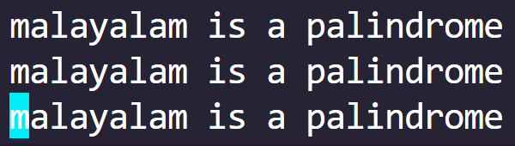
CHAPTER 5 SOLUTIONS
LOOP CONTROL INSTRUCTION
(d)
#include <stdio.h>
int main()
{
while ('a'<'b')
printf("malayalam is a palindrome\n");
return 0;
}
✍️ This is an indefinite loop. The program prints "malayalam is a palindrome" repeatedly in an infinite loop, as the condition 'a'<'b' is always true in ASCII character comparison, since ASCII value of 'a' and 'b’ are 97 and 98 respectively.
CH 5 Q[A](d)
👩‍💻
Output:
DEAR CODING
♾️ Infinite times…
BOOK: LET US C
BY YASHAVANT KANETKAR

Slide 9
CHAPTER 5 SOLUTIONS
LOOP CONTROL INSTRUCTION
(e)
👩‍💻 10 will be printed indefinitely.
#include <stdio.h>
int main()
{
int i;
while (i = 10)
{
printf("%d\n", i);
i = i + 1;
}
return 0;
}
CH 5 Q[A](e)
✍️10 gets assigned to i so the while is now reduced to while ( i ) or while ( 10 ). Since 10 is non-zero, so the while condition I = 10 is always true, and hence that control would keep rotating within the loop, eternally.
DEAR CODING
BOOK: LET US C
BY YASHAVANT KANETKAR

Slide 10
CHAPTER 5 SOLUTIONS
LOOP CONTROL INSTRUCTION
(f)
#include <stdio.h>
int main()
{
float x = 1.1;
while (x == 1.1)
{
printf("%f\n",x);
x = x - 0.1;
}
return 0;
}
👩‍💻 No output, since the float variable is compared with a double constant, condition will not satisfy.
CH 5 Q[A](f)
✍️ Either declare x as a double variable, instead of float or write 1.1f, instead of simply 1.1, while comparing it with the x (float variable). Then the output will be 1.100000
DEAR CODING
BOOK: LET US C
BY YASHAVANT KANETKAR

Slide 11
CHAPTER 5 SOLUTIONS
LOOP CONTROL INSTRUCTION
(f)
#include <stdio.h>
int main()
{
float x = 1.1;
while (x == 1.1)
{
printf("%f\n",x);
x = x - 0.1;
}
return 0;
}
👩‍💻 No output, since the float variable is compared with a double constant, condition will not satisfy.
CH 5 Q[A](f)
✍️ Either declare x as a double variable, instead of float or write 1.1f, instead of simply 1.1, while comparing it with the x (float variable). Then the output will be 1.100000
DEAR CODING
BOOK: LET US C
BY YASHAVANT KANETKAR

Slide 12
CHAPTER 5 SOLUTIONS
LOOP CONTROL INSTRUCTION
(f)
#include <stdio.h>
int main()
{
double x = 1.1;
while (x == 1.1)
{
printf("%f\n",x);
x = x - 0.1;
}
return 0;
}
👩‍💻 No output, since the float variable is compared with a double constant, condition will not satisfy.
CH 5 Q[A](f)
✍️ Either declare x as a double variable, instead of float or write 1.1f, instead of simply 1.1, while comparing it with the x (float variable). Then the output will be 1.100000
DEAR CODING
BOOK: LET US C
BY YASHAVANT KANETKAR

Slide 13
CHAPTER 5 SOLUTIONS
LOOP CONTROL INSTRUCTION
(f)
#include <stdio.h>
int main()
{
float x = 1.1;
while (x == 1.1f)
{
printf("%f\n",x);
x = x - 0.1;
}
return 0;
}
👩‍💻 No output, since the float variable is compared with a double constant, condition will not satisfy.
CH 5 Q[A](f)
✍️ Either declare x as a double variable, instead of float or write 1.1f, instead of simply 1.1, while comparing it with the x (float variable). Then the output will be 1.100000
DEAR CODING
BOOK: LET US C
BY YASHAVANT KANETKAR

Slide 14
CHAPTER 5 SOLUTIONS
LOOP CONTROL INSTRUCTION
Q[B] Attempt the following:
(a) Write a program to calculate overtime pay of 10 employees. Overtime is paid at the rate of Rs. 12.00 per hour for every hour worked above 40 hours. Assume that employees do not work for fractional part of an hour.
CH 5 Q[B](a)
DEAR CODING
BOOK: LET US C
BY YASHAVANT KANETKAR

Slide 15
CHAPTER 5 SOLUTIONS
LOOP CONTROL INSTRUCTION
Q[B] Attempt the following:
(b) Write a program to find the factorial value of any number entered through the keyboard.
CH 5 Q[B](b)
DEAR CODING
BOOK: LET US C
BY YASHAVANT KANETKAR

Slide 16
CHAPTER 5 SOLUTIONS
LOOP CONTROL INSTRUCTION
Q[B] Attempt the following:
(c) Two numbers are entered through the keyboard. Write a program to find the value of one number raised to the power of another.
CH 5 Q[B](c)
DEAR CODING
BOOK: LET US C
BY YASHAVANT KANETKAR

Slide 17
CHAPTER 5 SOLUTIONS
LOOP CONTROL INSTRUCTION
Q[B] Attempt the following:
(d) Write a program to print all the ASCII values and their equivalent characters using a while loop. The ASCII values vary from 0 to 255.
CH 5 Q[B](d)
DEAR CODING
BOOK: LET US C
BY YASHAVANT KANETKAR

Slide 18
CHAPTER 5 SOLUTIONS
LOOP CONTROL INSTRUCTION
Q[B] Attempt the following:
(e) Write a program to print out all Armstrong numbers between 1 and 500. If sum of cubes of each digit of the number is equal to the number itself, then the number is called an Armstrong number. For example, 153 = (1*1*1) + (5*5*5) + (3*3*3).
CH 5 Q[B](e)
DEAR CODING
BOOK: LET US C
BY YASHAVANT KANETKAR

Slide 19
CHAPTER 5 SOLUTIONS
LOOP CONTROL INSTRUCTION
Q[B] Attempt the following:
(f) Write a program for a matchstick game being played between the computer and a user. Your program should ensure that the computer always wins. Rules for the game are as follows:
There are 21 matchsticks.
The computer asks the player to pick 1, 2, 3, or 4 matchsticks.
After the person picks, the computer does its picking.
Whoever is forced to pick up the last matchstick loses the game.
CH 5 Q[B](f)
DEAR CODING
BOOK: LET US C
BY YASHAVANT KANETKAR

Slide 20
CHAPTER 5 SOLUTIONS
LOOP CONTROL INSTRUCTION
Q[B] Attempt the following:
(g) Write a program to enter numbers till the user wants. At the end it should display the count of positive, negative and zeros entered.
CH 5 Q[B](g)
DEAR CODING
BOOK: LET US C
BY YASHAVANT KANETKAR

Slide 21
CHAPTER 5 SOLUTIONS
LOOP CONTROL INSTRUCTION
Q[B] Attempt the following:
h) Write a program to receive an integer and find its octal equivalent. (Hint: To obtain octal equivalent of an integer, divide it continuously by 8 till dividend doesn't become zero, then write the remainders obtained in reverse direction.)
CH 5 Q[B](h)
DEAR CODING
BOOK: LET US C
BY YASHAVANT KANETKAR

Slide 22
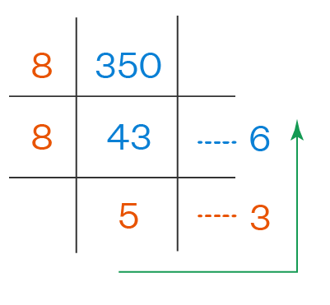
CHAPTER 5 SOLUTIONS
LOOP CONTROL INSTRUCTION
CH 5 Q[B](h)
DEAR CODING
BOOK: LET US C
BY YASHAVANT KANETKAR

Slide 23
CHAPTER 5 SOLUTIONS
LOOP CONTROL INSTRUCTION
Q[B] Attempt the following:
(i) Write a program to find the range of a set of numbers entered through the keyboard. Range is the difference between the smallest and biggest number in the list.
CH 5 Q[B](i)
DEAR CODING
BOOK: LET US C
BY YASHAVANT KANETKAR

Slide 24
LET US C
BY YASHAVANT KANETKAR
CH 6 Q[C]
CH 6 Q[A]
CH 6 Q[B]
CHAPTER 6 SOLUTIONS
MORE COMPLEX REPETITIONS

Slide 25


🔴Let me create amazing coding tutorials for you forever!🙂
👇👇👇👇👇👇👇👇👇👇👇👇👇👇👇👇👇👇
👉 SUBSCRIBE 🤛
CH 6 Q[C]
CH 6 Q[A]
CHAPTER 6 SOLUTIONS
MORE COMPLEX REPETITIONS
CH 6 Q[B]
Thanks for your valuable time!

Slide 26
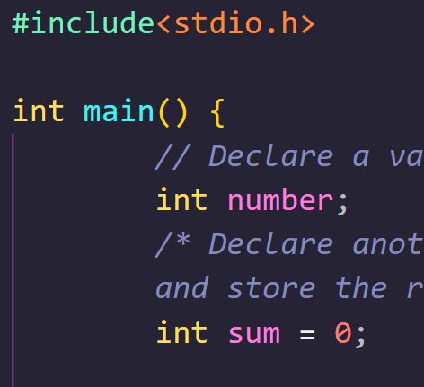
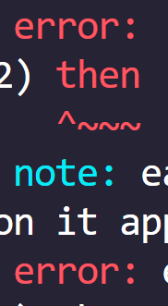

DEAR CODING

